Slide 1


The Battle of Neighborhoods - The Best Place for Cafe in Toronto
Wenwen Su

Slide 2
A contractor is looking to open a Cafe in Toronto, one of the most densely populated areas in Canada. He has contacted me for advice on the suitable neighborhoods to open the Cafe.
Introduction

Slide 3
In this case, we will utilize data science skills and the tools to use location data to explore Toronto neighborhoods, in order to help my contractor, and any other business owners who might be interested in starting their business in Toronto. the Cafe.
AUDIENCE

Slide 4
1. Wikipedia page of Toronto neighborhoods https://en.wikipedia.org/wiki/List_of_postal_codes_of_Canada:_M
Data section

Slide 5
1. Wikipedia page of Toronto neighborhoods https://en.wikipedia.org/wiki/List_of_postal_codes_of_Canada:_M 2. Geospatial Coordinates csv file http://cocl.us/Geospatial_data 3. Foursquare API https://api.foursquare.com
Data section

Slide 6
1. K-Means Clustering In this project, we will use K-Means Clustering algorithm to cluster the neighborhoods. 2. One Hot Encoding In this project, we will do one hot encoding for getting dummies of the venue category.
Methodology Section

Slide 7
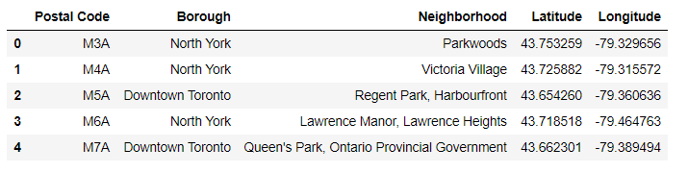
Create Dataframe
Create data frame of the postal code of each neighborhood along with the borough name, neighborhood name, latitude and the longitude.

Slide 8
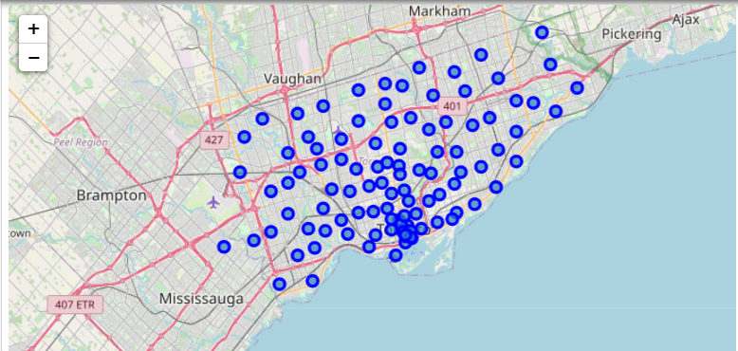
Use folium to produce a map for Toronto
Toronto Map

Slide 9
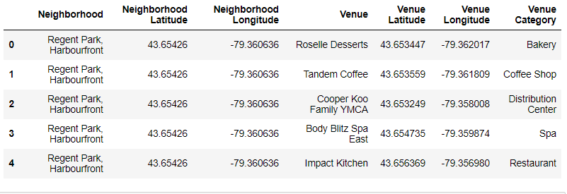
Venues Nearby
We will need to use the Foursquare location data and download all venues from all neighborhoods in Toronto.

Slide 10
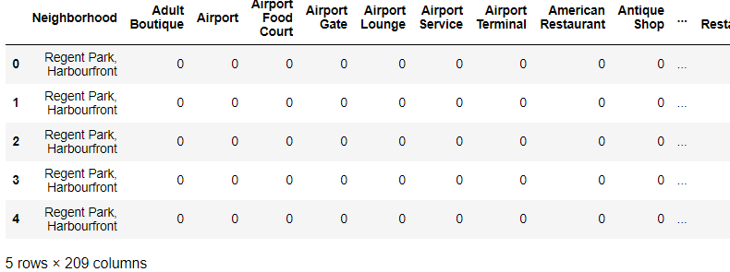
One Hot Encoding
We will use one hot encoding to analyze the neighborhoods.

Slide 11
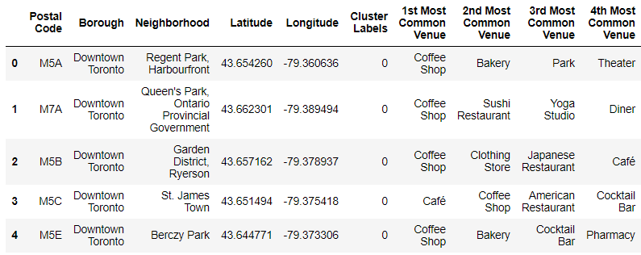
Cluster Neighborhoods

Slide 12
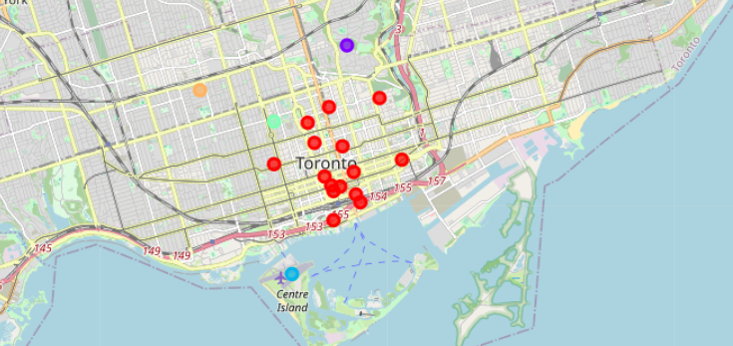
Map Clusters

Slide 13
According to the analysis, Rosedale in Cluster 1 will be the best place for my contractor to open his Cafe. As we built our K-Means dataset and list of neighborhoods with their most common venues, we discovered Cluster 1 provides comparatively less competition than Cluster 0, and closer distance to residentials than Cluster 2
Discussion Section

Slide 14
To conclude this project, we used Python libraries to handle JSON file, plotting graphs, and other exploratory data analysis. in order to help my contractor, and any other business owners who might be interested in starting their business in Toronto to find the best place for an upcoming Cafe.
Conclusion Section

Slide 15


